Slide 1

Careers in Computer Science
CSCI 1101 Introduction to Computer Science

Slide 2
Career options in cs
There are many career options available to computer scientists and they aren’t always in software companies such as Twitter(X), Facebook, or Google.
Examples of non-software companies:
Amazon
Space X
Caterpillar Inc.
General Motors
Bank of America

Slide 3
Careers in cs
Software Developer
Software Engineer
Web Developer
Game Developer
UI/UX Design
IT
Security Analyst
Database Engineer
AI Developer
And many more

Slide 4
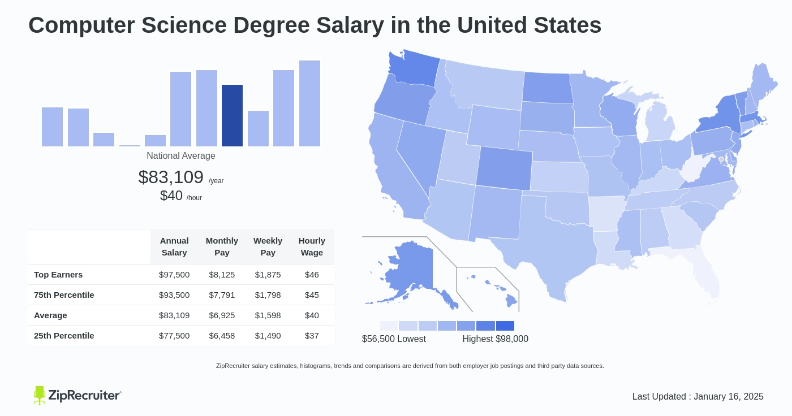
Salaries for cs majors
https://www.ziprecruiter.com/Salaries/Computer-Science-Degree-Salary

Slide 5
Software developer v. engineer
Software developers design specific computer systems and application software. Software engineers work on a larger scale to design, develop, and test entire computer systems and application software for a company or organization
Software development is a subset of software engineering.

Slide 6
Ui/ux designer
User experience (UX) refers to the user’s journey when interacting with a product or service. UX design is the process of creating products or services that provide meaningful experiences for users.
User Interphase (UI) design refers to the interfaces with which users engage. The UI design process may include buttons or widgets, text, images, sliders, and other interactive elements.

Slide 7
Web developer
Web developers usually fall under one of three categories: back-end developers, front-end developers, and full-stack developers. Some web developers also work as webmasters.

Slide 8
Game developer
Game developers typically play a role in several elements of game development, including visuals, artificial intelligence (AI), UI, and game logic. Game developers take the game designers' designs, storyboards, and ideas and use them as blueprints to bring the game to life as something gamers can actually play.
https://youtu.be/_tE4phLuGyA

Slide 9
Database engineer
Database engineers design and maintain databases, increase data storage capacity, and troubleshoot database functionality issues. They also review database performance and user reports.

Slide 10
Security analyst
Security analysts identify and correct flaws in the company’s security systems, solutions, and programs while recommending specific measures that can improve the company’s overall security posture.

Slide 11
Career in Research
Machine Learning: https://miutrgv.github.io/
Bioinformatics: https://faculty.utrgv.edu/marzieh.ayati/research.html
Algorithms & Theory: https://asarg.hackresearch.com/main/
Robotics: https://sites.google.com/view/qilu/

Slide 12
Kahoot Time!!!

Slide 13

Thank You

